Slide 1
CSE 471: MACHINE LEARNING
Modern RNN Architectures

Slide 2
Long Short-Term Memory (LSTM)
Memory cell
Keeps values in each memory cell’s internal state cascading along a recurrent edge with weight 1 across many successive time steps.
Avoids the vanishing gradient problem
Multiplicative gates

Slide 3
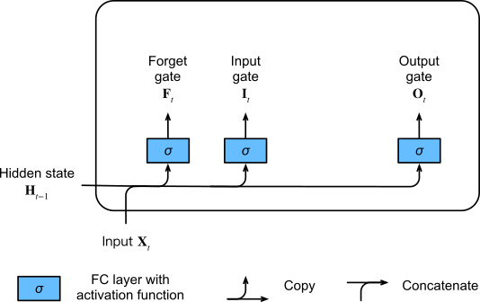
Long Short-Term Memory (LSTM)

Slide 4
Long Short-Term Memory (LSTM)
Input gate
  Whether a given input should impact the internal state
Forget gate
  Whether the internal state should be flushed to 0
Output gate
  Whether the internal state of a given neuron should be allowed to impact the cell’s output
If a token is of great importance we will learn not to update the hidden state after observing that.
Likewise, we will learn to skip irrelevant temporary observations.
we will learn to reset the latent state whenever needed.

Slide 5
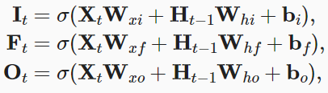
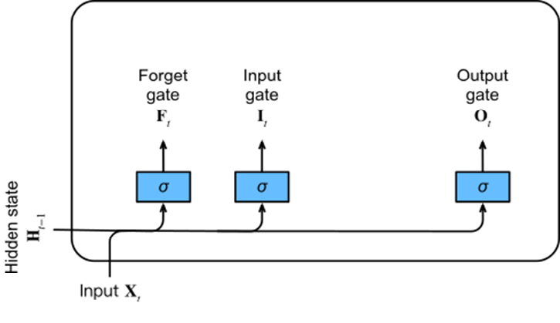
Long Short-Term Memory (LSTM)
X_{t} ∈ R^{n×d}
H_{t-1} ∈ R^{n×h}
I_{t} ∈ R^{n×h}
F_{t} ∈ R^{n×h}
O_{t} ∈ R^{n×h}
W_{xi} , W_{xf} , W_{xo} ∈ R^{d×h}
W_{hi} , W_{hf} , W_{ho} ∈ R^{h×h}
b_{i} , b_{f} , b_{o} ∈ R^{1×h}

Slide 6

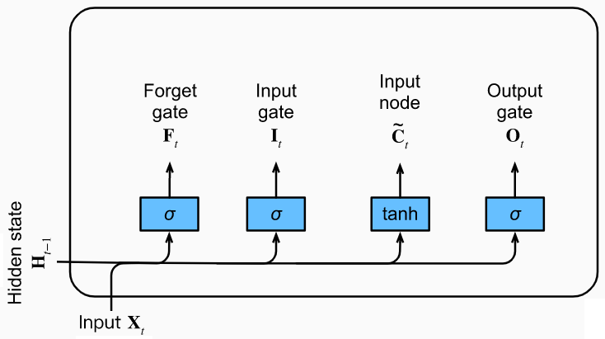
Input Node
W_{xc} ∈ R^{d×h}
W_{hc} ∈ R^{h×h}
B_{c} ∈ R^{1×h}

Slide 7


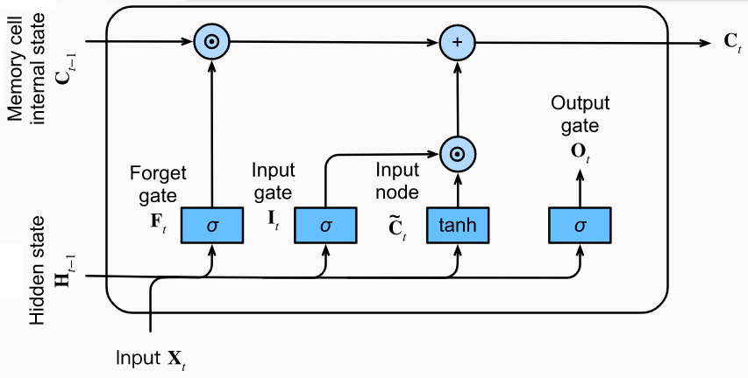
Memory Cell Internal State
Notes:
Hadamard (elementwise) product

Slide 8

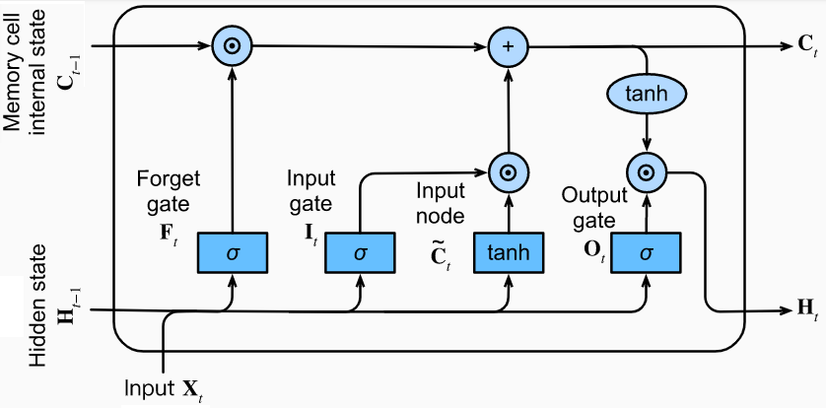
Hidden State
A memory cell can accrue information across many time steps without impacting the rest of the network (so long as the output gate takes values close to 0), and then suddenly impact the network at a subsequent time step as soon as the output gate flips from values close to 0 to values close to 1.
Notes:
Note that a memory cell can accrue information across many time steps without impacting the rest of the network (so long as the output gate takes values close to 0), and then suddenly impact the network at a subsequent time step as soon as the output gate flips from values close to 0 to values close to 1.

Slide 9
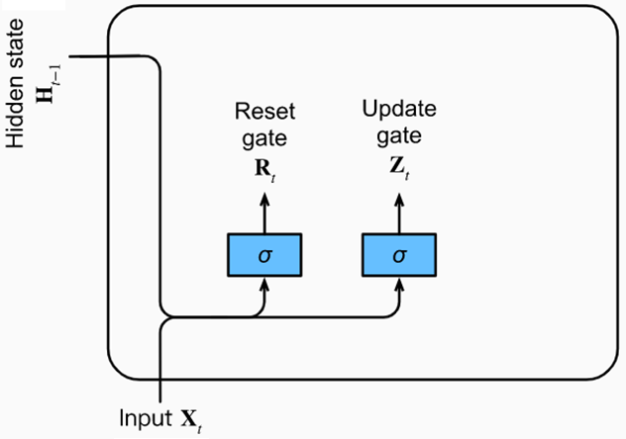

Gated Recurrent Units (GRU)
Reset Gate
Update Gate
W_{xr} ,W_{xz} ∈ R^{d×h}
W_{hr} ,W_{hz} ∈ R^{h×h}
b_{r} ,b_{z} ∈ R^{1×h}

Slide 10
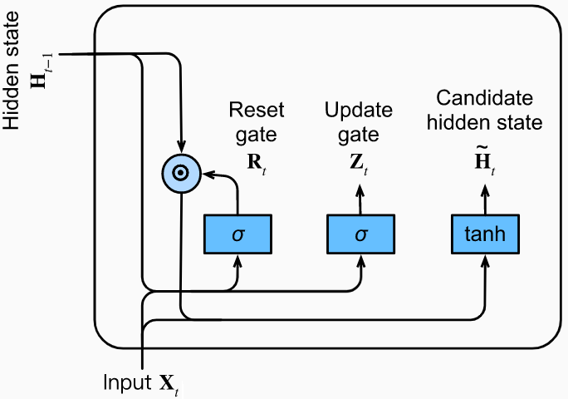
Candidate Hidden State
W_{xh} ∈ R^{d×h}
W_{hh} ∈ R^{h×h}
b_{h} ∈ R^{1×h}

Slide 11

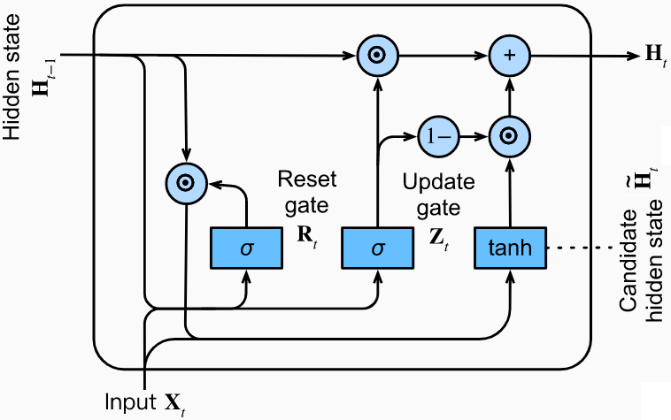
Hidden State

Slide 12
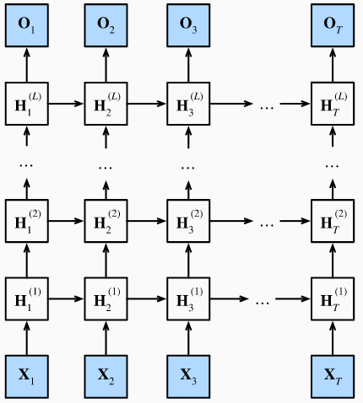
Deep RNN
Stacked RNNs on top of each other
Any RNN cell at each time step depends on both the same layer's value at the previous time step and the previous layer's value at the same time step.

Slide 13


Deep RNN
W_{hq} ∈ R^{h×q}
b_{q} ∈ R^{1×q}
W_{xh}^{(l)} ∈ R^{h×h}
W_{hh}^{(l)} ∈ R^{h×h}
b_{h}^{(l)} ∈ R^{1×h}

Slide 14
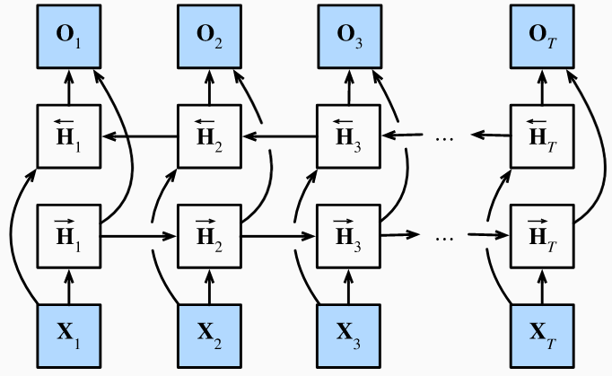
Bidirectional RNN

Slide 15
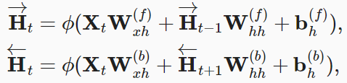

Bidirectional RNN
W_{xh}^{(f)} ∈ R^{d×h}
W_{hh}^{(f)} ∈ R^{h×h}
W_{xh}^{(b)} ∈ R^{d×h}
W_{hh}^{(b)} ∈ R^{h×h}
b_{h}^{(f)} ∈ R^{1×h}
b_{h}^{(b)} ∈ R^{1×h}

Slide 16
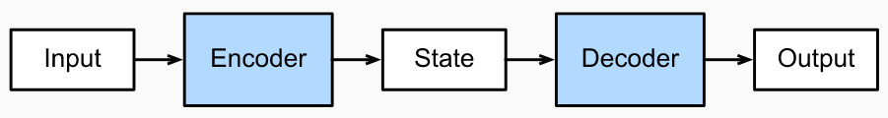
Encoder-Decoder
Encoder takes a variable-length sequence as input
Decoder acts as a conditional language model
  Looks at the encoded input
  Looks at leftwards context of the target sequence
  Predicts subsequent token in the target sequence

Slide 17
Encoder-Decoder
Teacher Forcing
  Original target sequence is fed into decoder as input
  Alternate approach: feed the predicted token from the previous time step.
Encoder RNN
  Variable-length sequence as input
  Fixed-shape hidden state
Decoder RNN
  Input
    The input sequence
    The preceding tokens in the output

Slide 18
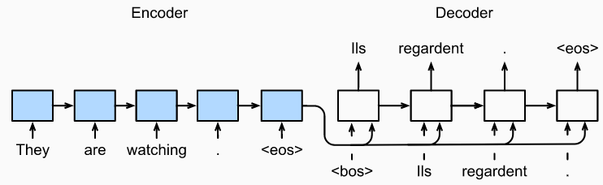
Encoder-Decoder

Slide 19
Encoder
Input sequence x₁, x₂, … x_{T}
h_{t} – Hidden state
  h_{t} = f(x_{t}, h_{t-1})
  c = q(h₁, h₂, …, h_{T})
  Unidirectional RNN
Bidirectional RNN
  Hidden state depends on the subsequence before and after the time step

Slide 20


Decoder
The decoder assigns a predicted probability to each possible token occurring
Hidden state of decoder
Prediction of padding tokens should be excluded from loss calculations.
We can mask irrelevant entries with zero values so that multiplication of any irrelevant prediction with zero equals to zero.

Slide 21
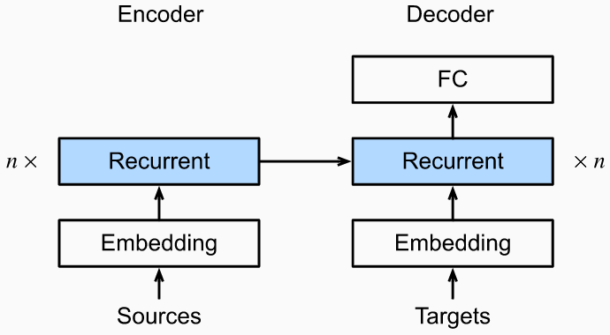
Encoder-Decoder
Softmax to obtain distribution of tokens at each time stamp
Cross-entropy loss for optimization

Slide 22
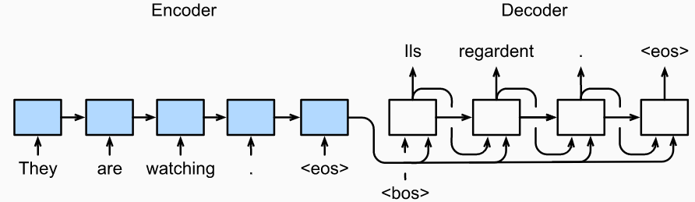
Prediction
<bos> token is fed at the initial time step
At each subsequent time step, sample the token with highest probability.
The predicted token is fed into the next time step
Prediction is completed when <eos> is emitted

Slide 23
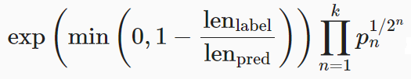
Evaluation
BLEU (Bilingual Evaluation Understudy)
  For any n-grams in the predicted sequence, BLEU evaluates whether this n-grams appears in the target sequence.
p_{n} – Precision of n-gram
len_{label} – Number of tokens in the target sequence
len_{pred} – Number of tokens in the predicted sequence
Notes:
To explain, given a target sequence A,B,C,D,E,F and a predicted sequence A,B,B,C,D we have p₁=4/5, p₂=3/4, p₃=1/3, and p₄=0.

Slide 24
Evaluation
Whenever the predicted sequence is the same as the target sequence, BLEU is 1.
Matching longer n-grams is more difficult
  BLEU assigns a greater weight to a longer n-gram precision
Predicting shorter sequences tends to obtain a higher p_{n} values
  Coefficient before the multiplication term penalizes shorter predicted sequences
Notes:
For example, when k=2, given the target sequence A,B,C,D,E,F and the predicted sequence A,B, although p₁=p₂=1, the penalty factor exp⁡(1−6/2)≈0.14 lowers the BLEU.

Slide 25


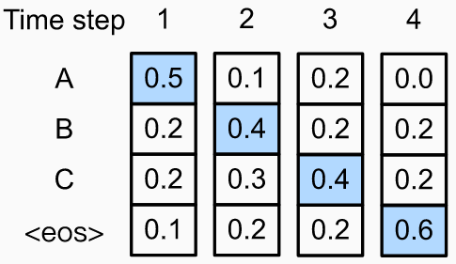
Beam Search
Select the token with the highest conditional probability
The most likely sequence maximizes the expression:
The conditional probability of this output sequence is 0.5×0.4×0.4×0.6=0.048
Notes:
At each time step, greedy search selects the token with the highest conditional probability. Therefore, the output sequence "A", "B", "C", and "<eos>" will be predicted. The conditional probability of this output sequence is 0.5×0.4×0.4×0.6=0.048

Slide 26
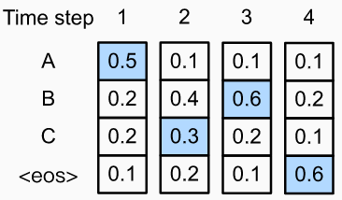
Beam Search
The conditional probability of the output sequence "A", "C","B" and "<eos>" is 0.5×0.3×0.6×0.6=0.054
Notes:
Since the output subsequences at time steps 1 and 2, on which time step 3 is based, have changed from "A","B" to "A","C", the conditional probability of each token at time step 3 has also changed.
Suppose that we choose the token "B" at time step 3. Now time step 4 is conditional on the output subsequence at the first three time steps "A","C" and "B", which is different from "A","B" and "C".
The conditional probability of the output sequence "A", "C","B" and "<eos>" is 0.5×0.3×0.6×0.6=0.054

Slide 27
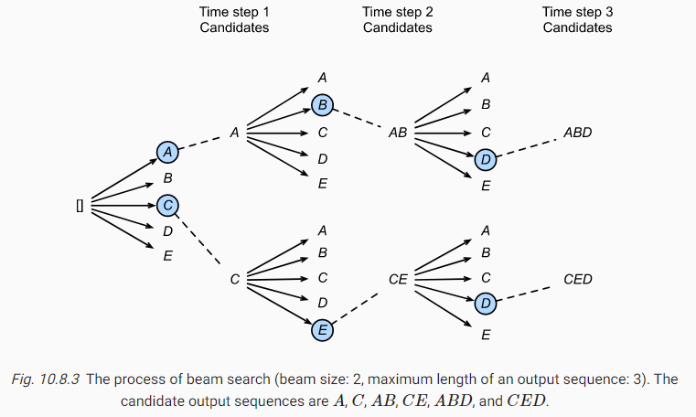
Beam Search

Slide 28
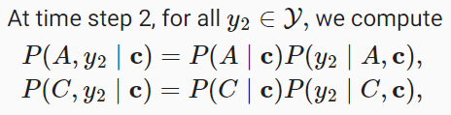
Beam Search
Beam size = 2
Maximum length of output sequence = 3
At time step 1, tokens with highest P(y₁|c) are A and C.
Pick the largest 2 among these 10 values, say
  P(A,B | C) and P(C,E | c)

Slide 29
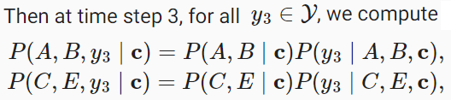
Beam Search
Pick the largest 2 among these 10 values, say
  P(A,B,D | c) and P(C,E,D | c)

Slide 30


Beam Search
Choose the sequence with highest score
L – length of final candidate sequence
α = 0.75
Since a longer sequence has more logarithmic terms, the term L^{α}
in the denominator penalizes long sequences.
Running Time

Slide 31
Encode-Decoder with Attention (Bahdanau et al.)
The most likely sequence maximizes the expression:
In RNN: p(y_{t}|y₁, y_{2,} ... , y_{t-1}, x) = g(y_{t-1}, s_{t}, c)
Modified Architecture
  p(y_{i}|y₁, y_{2,} ... , y_{i-1}, x) = g(y_{i-1}, s_{i}, c_{i})
  s_{i} = f(s_{i-1}, y_{i-1}, c_{i})

Slide 32
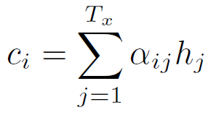
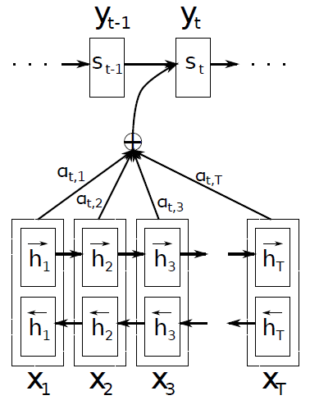
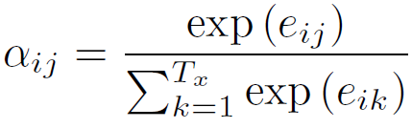

Alignment model - How well the inputs around position j and the output at position i match.
Jointly trained as a FNN
Notes:
h_{j} are the encoder hidden states.
α_{ij} – Weight of annotation h_{j} to context vector c_{i}

Slide 33
Alignment model
The probability α_{ij} , or its associated energy e_{ij} , reflects the importance of the annotation h_{j} with respect to the previous hidden state s_{i-1} in deciding the next state s_{i} and generating y_{i}
Intuitively, this implements a mechanism of attention in the decoder – the decoder decides parts of the source sentence to pay attention to.
By letting the decoder have an attention mechanism, we relieve the encoder from the burden of having to encode all information in the source sentence into a fixed length vector.
With this new approach the information can be spread throughout the sequence of annotations, which can be selectively retrieved by the decoder accordingly.

Slide 34
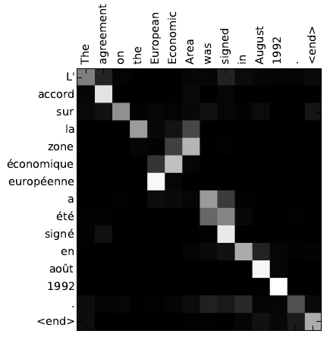
Attention
The x-axis and y-axis of each plot correspond to the words in the source sentence (English) and the generated translation (French), respectively.
Each pixel shows the attention of the j-th source word for the i-th target word in grayscale (0: black, 1: white).

Slide 35
Transformer (Attention Is All You Need)
No recurrent unit
Self-attention
Position encoding
Parallelization

Slide 36
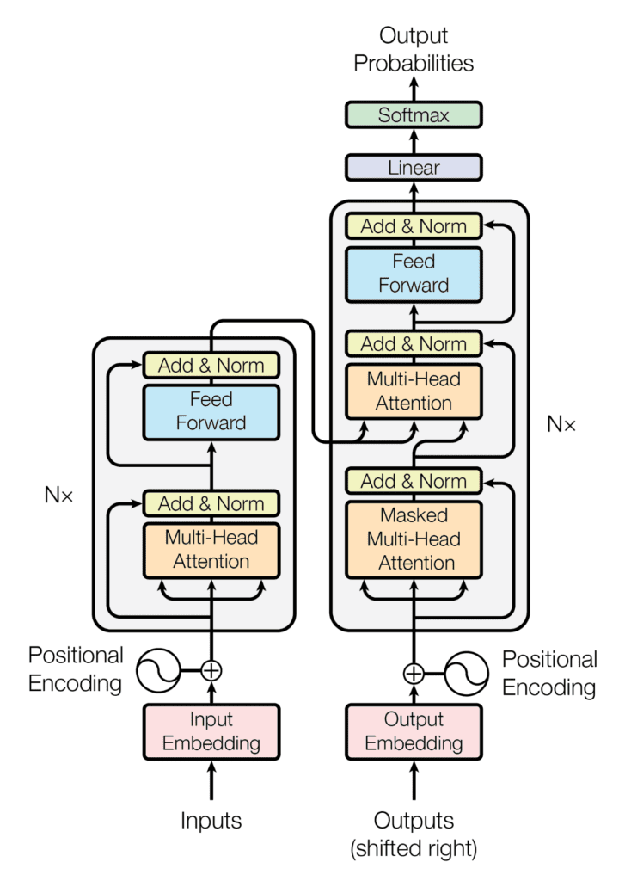
Transformer Architecture

Slide 37
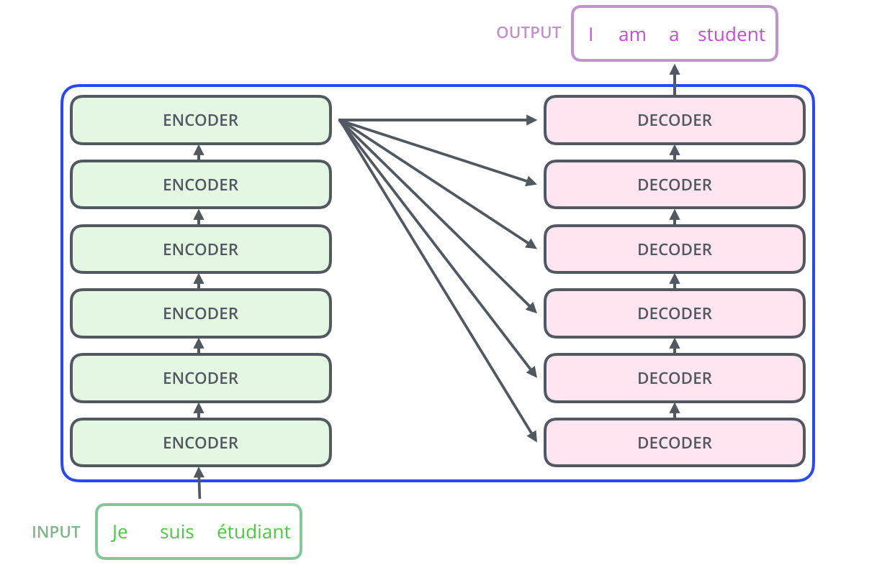
Stacked encoders and decoders
Image taken from https://jalammar.github.io/illustrated-transformer/

Slide 38
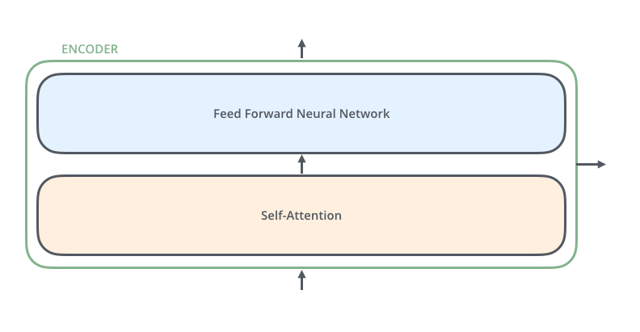
Encoder
Self-attention layer helps the encoder look at other words in the input sentence as it encodes a specific word.
The outputs of the self-attention layer are fed to a feed-forward neural network.
Image taken from https://jalammar.github.io/illustrated-transformer/

Slide 39
Position-wise Feed-Forward Networks
Each of the encoder and decoder layers contains Fully connected FFN
Applied to each position separately, identically
FFN(x) = max(0, xW₁ + b₁)W₂ + b₂
  Same parameters across different positions
  Different parameters in different layers

Slide 40
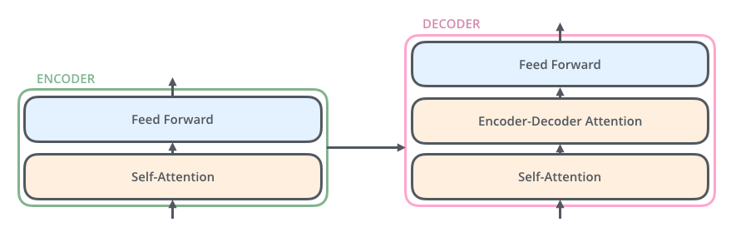
Decoder
Between the FFN and self-attention layers, there is another attention layer.
This layer helps the decoder focus on relevant parts of the input sentence.
Image taken from https://jalammar.github.io/illustrated-transformer/

Slide 41
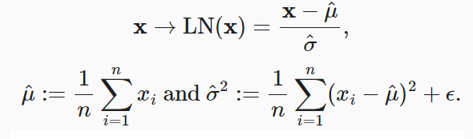
Layer Normalization
Does not depend on minibatch size
Same transformation during training and testing
Scale independent
  LN(x) ≈ LN(αx) [For α ≠ 0]

Slide 42


Remember Batch Normalization?
Sample mean
Shift parameter
Element-wise scale parameter
Sample Standard Deviation
At prediction time, population mean and standard deviations are used.
Like dropout, the model sees the noise (in mean and SD) only during training

Slide 43
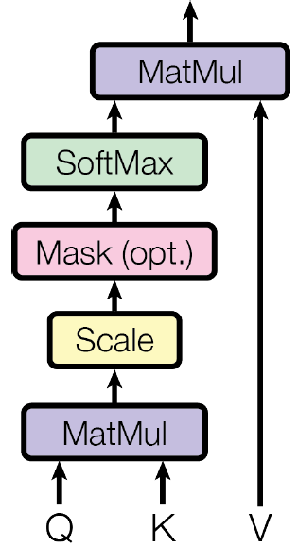
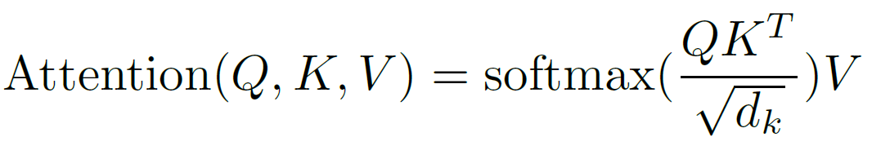
Scaled Dot-Product Attention
Dot-product attention is much faster and more space-efficient in practice, compared to additive attention, since it can be implemented using highly optimized matrix multiplication code.
Notes:
d_{k} – dimension of query and key
D_{v} – Dimension of value

Slide 44
Query (Q), Key (K) and Value (V)
These are abstract vectors are created by multiplying the input embedding by three matrices (W^{Q}, W^{K} and W^{V}) that we trained during the training process.

Slide 45
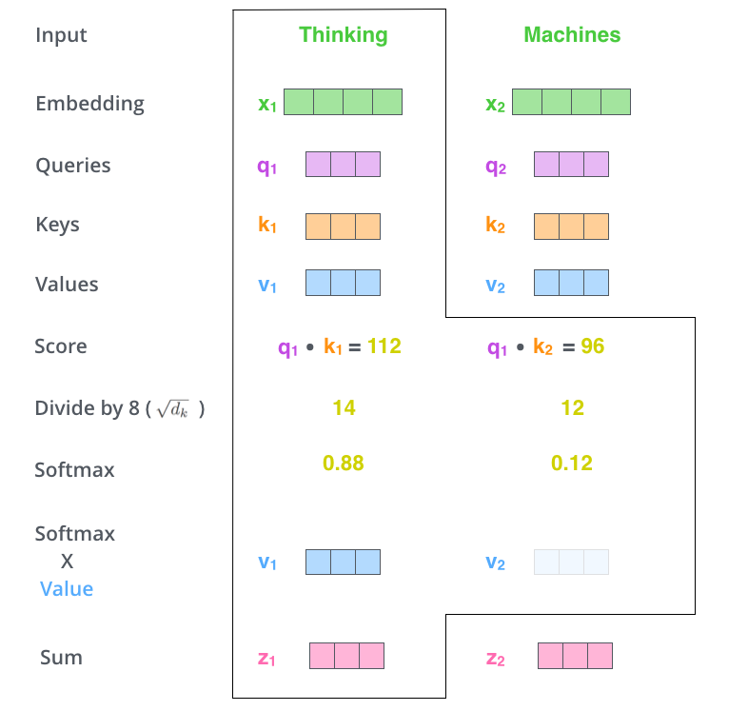
Image taken from https://jalammar.github.io/illustrated-transformer/

Slide 46

Reason for scaling with
For small values of d_{k} both dot product and additive attentions perform similarly
Additive attention outperforms dot product attention without scaling for larger values of d_{k}
Likely, for large values of d_{k}, the dot products grow large in magnitude, pushing the softmax function into regions where it has extremely small gradients. To counteract this effect, we scale the dot products by

Slide 47
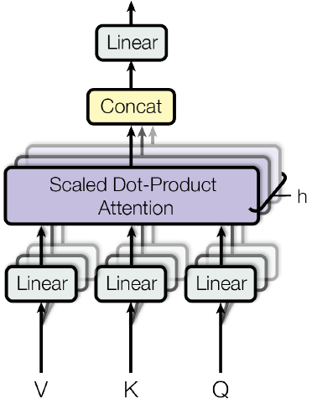
Multi-Head Attention
Several attention layers running in parallel (h=8)
d_{k} = d_{v} = d_{model}/h = 64
Due to the reduced dimension of each head, the total computational cost is similar to that of single-head attention with full dimensionality

Slide 48
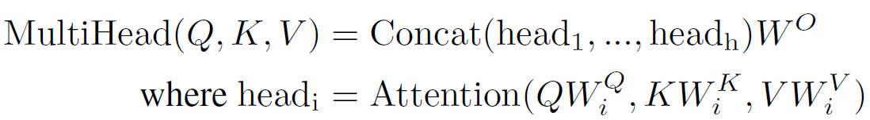
Multi-Head Attention
W_{i}^{Q} ∈ R^{d_model×d_k}
W_{i}^{K} ∈ R^{d_model×d_k}
W_{i}^{V} ∈ R^{d_model×d_v}
W^{O} ∈ R^{hd_v×d_model}

Slide 49
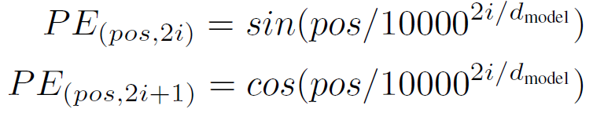
Positional Encoding
The wavelengths form a geometric progression from
  2π to 10000×2 π
Positional encoding is added to the input embedding
Both have the same dimension d_{model}

Slide 50
Optimizer
Adam optimizer
Variable learning rate
  Increasing the learning rate linearly for the first warmup_steps (4000) training steps
  Thereafter, decreasing proportionally to the inverse square root of the step number

Slide 51
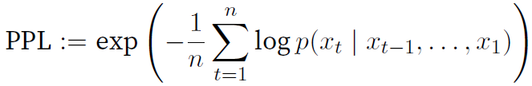
Regularization
Dropout
  P_{drop} = 0.1
Label smoothing
  Improves accuracy and BLEU
  Hurts perplexity (as the model learns to be more unsure)

Slide 52
Label smoothing
Regularization
  Reduce overfitting
  Reduce overconfidence
y_ls = (1 - α) * y_hot + α / K
  If α=0, we get back the original y_hot
  If α=1, we get uniform distribution
Used when
  Loss function is cross entropy
  softmax is used

Slide 53
Label smoothing
One-hot encoded labels encourage largest possible gaps in the vector to be fed into the softmax function.
  May make the model less adaptive and too confident
Smoothed labels encourages small gaps in the output (before softmax)

Slide 54
Label smoothing Example
Let there be 3 classes, with a data point belong to the first class. y_hot = [1 0 0]
Vector [10 0 0] results very close to y_hot values after softmax [0.9999 0 0]
Now, with label smoothing (α=0.1),
  y_ls = [0.9333 0.0333 0.0333]
Vector [3.3322 0 0] results very close to y_ls values after softmax
  It has smaller gaps

Slide 55
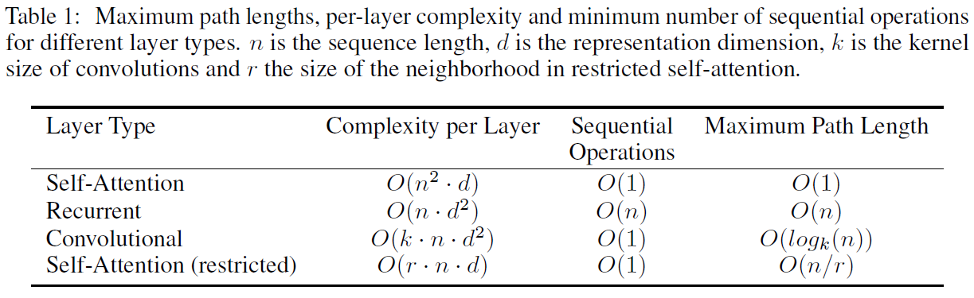
Complexity comparison
Notes:
In terms of computational complexity, self-attention layers are faster than recurrent layers when the sequence length n is smaller than the representation dimensionality d, which is most often the case with sentence representations used by state-of-the-art models in machine translations.

Slide 56
Transformer References
Attention is All You Need
The Illustrated Transformer
Talk by Łukasz Kaiser
Transformer Neural Networks - EXPLAINED!

